Slide 1

PRWATECH
Share Ideas, Start Something Good.
Training Center Collaboration Deck

Slide 2
Who We Are?
PRWATech is India’s leading and largest training provider for Big Data and Hadoop Corporate training programs. We have expanded our domain to all the technologies and Programming Languages
We are a highly skilled team of Solution managers and Software Engineers working together in order understand the requirements and provide the most efficient and economical business offering under any circumstances.
Mission Statement
6 Years of Digital
Skills Training
150 + Industry Grade Trainers
Working together with client, we still strive to provide the highest learning opportunities with cost efficient modules. We aim to create responsible, independent individuals who have skills to grow & aspire to learn to build their career.
100,000+ Professionals Trained in over 20 Countries
Placement Tie-ups with 40+ MNCs

Slide 3
The PRWATECH Advantage
Synergized Training with Hands on Sessions
Service with
Quality
Self Paced and Customized Courses
Access to 5000+ expert led Courses
ISO Certification at Module Completion
Use project files and quizzes to practice while you learn
PRWATech provides a cutting-edge enhancement training to all the Students, so that when they enter the Corporate World, they are equipped with the latest tools.
It basically paves the way for them to shine throughout their careers!

Slide 4
Services and Offerings

Slide 5
Our Product Portfolio
Recruitment Solutions
Self-Paced Online Training
Post the certification of the Students, they are offered internship program with several companies which has high ratio of full-time job conversion
VI
I
Learner can control the amount of material they consume as well as the duration of time they need to learn the new information properly
Instructor-Led Live,
Online Training
LMS
Highly Interactive Learning Sessions with the help of Video tools and self paced courses
V
II
Structured Knowledge Sharing sessions available over the web with expert assistance and round clock support
Webinar Sessions
On-Premise Classroom Training
Structured Knowledge Sharing sessions available over the web through pre-registration
IV
III
Train your Students with exclusive instructor led batches, with hands on training and live projects

Slide 6
PRWATECH: Value Offering
All Domains: Unlimited Access
Expert Instructors
Self Paced and Customizable
Select what you would like your
students to learn from our Extensive Subscription Library
Learn from industry experts who
are passionate about teaching
Learn at your ease at your
Available timings and with loads of
Customization options

Slide 7

Empowering the Training Centers
Time to get Online!

Slide 8

Make your Classroom Online
PRWATech has come up with a Unique Platform where Individual Trainers or a Group of Trainers can bring their entire Classroom Training to PRWATech’ s Learning Portal and increase their audience and Student Pool
Enter new territories with Global Appeal
Dynamic Platform with option of 24/7 Tech Support
Partnership with Global Player
Association in Online Promotion
No Infrastructure Setup Cost
Online Visibility
Demo Classes
Robust & Dynamic
Revenue Multiplier
Ride along the already prominent PRWATech and avail superior benefits
Put all your Demo Classes online and save time for regular classes or content creation
Option available for 24/7 Technical Support based on the partnership terms
Online enrollments come at no extra cost and time

Slide 9
Become a part of the Digital Revolution!
Select Bundle
Website Access
Content Creation
Choose among the various bundles available for Partnership with PRWATech
Each Bundle comes with Unique benefits, Course Layout, Revenue and Visibility Options
Choose best suited to your Business Needs
Every Institute/ Individual Trainer to get a Unique URL for his site
Customizations enabled to tailor the Course Material as per the need
Separate Student Credentials and CRM to be made available as per the bundle opted
PRWATech Team will guide and provide infrastructure to convert Classroom Teaching to Online Courses
Create Demo Classes, Full Course Videos or special Training Snippets based on your needs
Enrollment
Promotion and Demos
Any Enrolled Student will get credentials from the Institute and can access the materials he has paid for
Complete CRM and Lead Management System to support
PRWATech’ s Platform can be used for Demo Sessions to New Joiners saving Time and Effort
Online Promotions to be carried out based on the initial bundle selection

Slide 10
The PRWAdavantage
Grow Online
Customized CRM
Follow the Digital Revolution and get your Training Centre Online with PRWA URL
Manage your Customers and respective Loyalty Programs
Global Audience and Leads
Self Paced Courses
With PRWATech’s Global Presence, ride along and show your Courses to the World
You can also create More valued Self Paced courses with PRWATech’s Help
Demo Classes
Deliver more to Customers
Save time for your Demo by sharing Demo over PRWA Platform
The student gets automatically added as a lead with Follow up communications
Conduct Webinars, share Classroom notes and offer internships to your students

Slide 11
Collaboration Offerings
Huge Library of Courses
24/7 Technical Support
The training center student gets access to huge plethora of courses apart from the ones that are taught at the Training Centre, thereby attracting more enrollment and loyalty from Students
The best trainers from the world are here to solve your enrolled students queries all days and all hours of the week. Show the students that you care for their success
Self Paced Course Demo
Certifications
The students can also be given demo sessions for Self Paced Courses via your center. Review before you enroll
Certifications and Course Specialization offers for every course. CO-Branding for your Institute on Certificates as well
Co-Branding
Project and Assessment Solutions
Your training center becomes official partner of Bangalore's No.1 Classroom Training for Data Science and Big Data. Branding benefits like social media collaboration and co-hosting events, seminars and webinars
Increase the level of competition among your students with Live Project access and industry scaled assessments at different levels

Slide 12
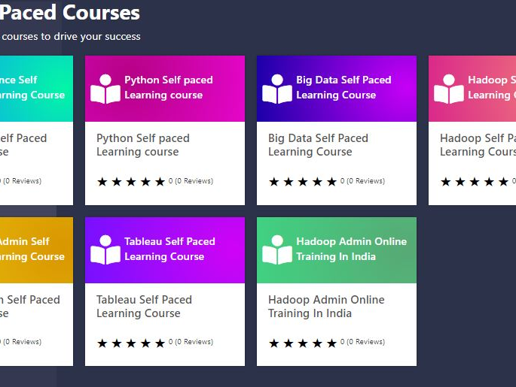
Grow your Business
Add a “Digital Touch” to your Center
With the ever-growing competition in the Education and Training sector, add a distinguishing factor by partnering with us and entering the Digital Training world
Attract more enrollments with huge course library
Increase Student Loyalty with 24/7 Technical support for your existing courses
Placement and Internship assistance based on performance in Standardized Tests
Co-Branding
Recruitment Solutions
Student Engagement
Digital Advantage
Customized URL for Enrollment
Certificates Logo Addition
Website and Social Media Mentions
Interview Opportunities/ Internship Opportunities
Placement Counselling
Partnership with MNCs and visibility
Improve student engagement with 24/7 tech Support
Attract enrollment for more courses
Futurized and User-Friendly navigation
Dashboards to track all activities

Slide 13
Course Library
AI and Machine Learning
Azure Administrator
Tableau Training and Certification
AWS Architect Certification
Python Spark Certification
AI and Machine Learning
BIG Data Hadoop Certification
Cybersecurity
Data Analyst Masters
Python Certification
Google Cloud Certification
R Decision Tree Modeling
Data Science Elementary
Apache Kafka Certification
Advanced Predictive Modeling
Cloud Architect
Microsoft BI
IoT Certification
… and many more!

Slide 14
Domain Expertise
Big Data Analytics
Cloud
Data Engineer
Project Management
AWS
Azure
Google Cloud Platform
Cloud Architect
AWS Developer Associate
Microsoft Azure Architect
Hadoop
Spark and Scala
Data Science
Machine Learning
Introduction to Artificial Intelligence
Data Science with Python
Deep Learning with TensorFlow
Py-spark Training
Big Data and Hadoop Administrator
Introduction to Big Data
Big Data Hadoop and Spark Developer
Pyspark Training
Big Data and Hadoop Administrator
MongoDB Developer and Administrator
Simplifying Data Pipelines with Apache Kafka
Big Data on AWS
Agile Scrum Master
Certified Lean Six Sigma Green Belt
DevOps Certification
Digital Transformation for Leaders
Digital Skills in Data and AI
Digital Marketing for Leaders
Business Insights and Visualizations
DevOps
Tableau
Power BI
Microsoft BI
AI
Agile Scrum Master
DevOps
AWS SysOps Associate
Puppet
Agile and Scrum Foundation
Fundamentals of HTML
Fundamentals of CSS
Advanced HTML
Advanced CSS
DevOps Certification
JavaScript Certification Training
React with Redux
Node.js
SQL Training
Mongo DB for Developers and
Administrators
Getting Started with
Automation Testing
Other Technologies
Full Stack Web
Developer
Java
Advanced Java
PHP – CodeIgniter
C, C++
Tally
Operating Systems
Microprocessors

Slide 15








Self- Paced: How it Works?
Final Assessment
Student Watches the Videos
Live Webinar Classes
Online Enrolment
Project Work
Web and Mobile Access
Chapter End Quizzes
Live Interaction and Mentoring
Virtual Labs
Anytime/Anywhere
Self Paced Learning
Live Interaction
Hands on Experience
Placement Opportunities with MNCs

Slide 16
Placement and Internships
Student Pool – Getting Certified
Through PRWATech
PRWAGold Students - Screening pool for 200 + MNCs
Internship Opportunities at PRWATech Partner Companies
PRWASelect – Placement opportunity from MNC
Students covered under the course are trained in latest technologies through a combination of Self paced and Webinar sessions
Post certification, students are screened through 3 Layers of Tests for MNC recruitment options
Based on Screening Scores, students will be offered internships programs at Leading Companies
Special assistance to PRWAGold Students to get them through MNC interviews

Slide 17
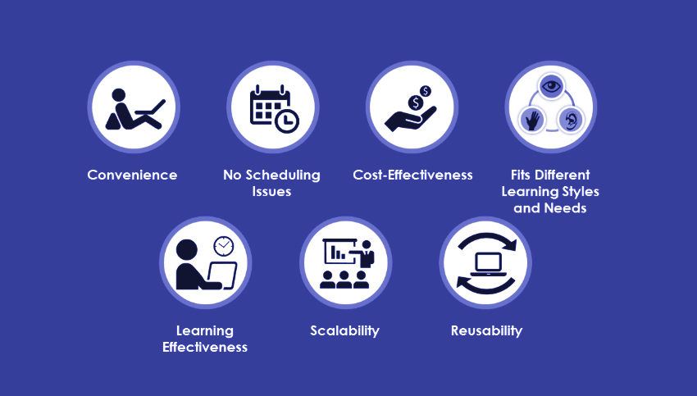
Self Paced Courses for Students: Why?

Slide 18
Convenience
Fits Different Learning Styles and Needs
Self-paced learning gives learners the convenience of learning anytime and anywhere. This gives them an opportunity to balance work and training. They need not fret on not being able to attend scheduled training programs because of work commitments. With self-paced learning, they can choose their time and whether they want to learn at work or at home. Another advantage is, this training can be fit into the employee’s schedule based on their personal preferences or job responsibilities. This convenience encourages employees to finish the course, which significantly reduces dropout rates
We know that different people have different learning styles. While some may prefer to go through the content multiple times to understand it, others can grasp the meaning after one reading. Some learners require more time to complete a course, while others may not. When learning and comprehension times vary, quick learners may have to wait for others to complete the course while slow learners will have to struggle to keep pace with others. Self-paced learning will suit all types of learners because everyone learns at their own pace
Learning Effectiveness
No Scheduling Issues
Learners tend to learn better when they learn at their own pace. This is because they allocate the learning time based on the difficulty of the study material. This improves the retention of difficult subjects because they will devote more time to it and focus their energies on learning
While self-paced learning offers convenience to learners, it also eliminates scheduling issues for the organization. Scheduling is an issue when you have to train a large number of people by gathering them at the same time. Scheduling issues, rescheduling, or cancellations do not occur with self-paced learning, as the training manager only needs to launch a training program and set a date for its completion
Scalability and Reusability
Self-paced learning provides scalability because you can train as many people as you want, with modest incremental costs. Once you have developed the curriculum and training material, which could be your only investment, you can spread the training among as many employees as you choose. When the training is designed for courses that you will be using again and again (think of training on compliance policies or standard training manuals), self-paced learning is a wise choice. Using it for permanent content removes the need to have live facilitators and related scheduling concerns
Cost-Effectiveness
Virtual training involves accrued costs of paying the instructor and for the technology. Self-paced learning does not involve these costs, the only investment is in developing the course. So, it is highly cost-effective

Slide 19
Advantages for Students
Convenience and Self-Scheduling
24/7 Technical Support
With self-paced learning, they can choose their time and whether they want to learn at work or at home
Having a Doubt? Students just drop in a ping or call our live Tech Support. The best professionals are always on the lookout for your queries!
Placement Assistance
Internship and Projects
With the guaranteed interview for those who pass screening test, more and more students are going to be inclined to excel at the courses and hence better results for everyone
Get the feel of what is like to actually work in MNCs and Corporates with refined Industry Grade Projects and exciting Internship Opportunities

Slide 20
Customizable Offerings
Tailor-Made Courses
24x7 Support
Flexible Engagement Model Tailor-Made for Your Needs
Round-the-Clock Support by In-House Subject-Matter Experts
Wisdom Analytics
Certifications
Customized Dashboard to Visualize Training Progress
Industry Recognized Certification to Add Value to Your Workforce
Hands-on Cloud Sessions
Projects
Hands-On Experience on Projects Pre-Configured to Get Started Immediately
Right Mix of Theoretical and Practical Training for Real World Industry Problems

Slide 21


Existing Partner Companies

Slide 22





Our Expert Team
Prinshu Verma
Nilesh Pandey
Aditya Gupta
Supported by Global Network of Professional Trainers
Top 10 Global Big Data, IoT, Data Science, Business Intelligence Influencer by Onalytica
Top 50 Big Data, Hadoop Trainer, Spark, Digital Media Influencer
IIM Lucknow Graduate, Big Data Analytics and Data Science
400+ teaching assistants and instructors providing 24/7 Learning guidance and support

Slide 23
Partnership Avenues

Slide 24
Partnership Plans
Student Enrollment # (Per Quarter) | Course Fees to be charged | PRWATech Charges (Per Enrollment in INR)
Less than 15 | Training Partner can Determine | 4000
Greater than 15 and Less than 30 | Training Partner can Determine | 3000
Greater than 30 and Less than 50 | Training Partner can Determine | 2000
Greater than 50 and Less than 100 | Training Partner can Determine | 1500
Greater than 100 | Training Partner can Determine | 1000
No Initial/ Joining Fees
No Term Charges

Slide 25
Testimonials
Garima Jalota
Learning at each step PrwaTech has been striving to help individual business by providing the accurate technology to harness the best of their efforts. Understanding the problem is far more important than solving the problem.
Big Data Analyst, DELL
IIM Bangalore
We provide the most optimized and customizable applications for business not only on a large scale but also on the smaller scale to help and support the upcoming entrepreneurs. In the ever developing field of technology we provide a strong, versatile foundation to support IT companies in the areas of BIG DATA and HADOOP Mainframes.
Abhimanyu Singh
AVP, CITI Bank

Slide 26
Media Releases

Slide 27

Press Covers
Times of India
20.05.2014
https://https://timesofindia.indiatimes.com/defaultinterstitial.cms
The Hindustan Times
17.08.2015
https://www.hindustantimes.com/
The Hindu
20.10.2016
http://www.thehindu.com/opinion/editorial/

Slide 28
PRWATech: Classroom Training
Multiple Classroom Training Centers
We have multiple training centers across the country and all are equipped with high end digital learning facilities and experienced Faculties
Weekend Classes
Webinars
Weekend classes at your College/ University
Available with PRWATech Faculty
We conduct weekly webinars for
Students and professionals across the globe.
Free access would be given with partnership
Monthly Classes
On Center Training
Monthly Visits by PRWATech Faculty for
Doubt Clearing Sessions also available
Students visiting PRWATech Centers and getting the required
Guidance when needed

Slide 29
Contact
Priyanshu Verma | +91 8951603761
+91 8951603761
+91 7045155846
BTM
No 14, 29th Main Road, 2st Cross
BTM Layout, 1st Stage, Behind Axa Building,
Land Mark : Vijaya Bank ATM,
Bangalore – 560 068
Karnataka, INDIA
www.prwatech.in
info@prwatech.in

Slide 30

Start with a Partnership Now!

